Slide 1
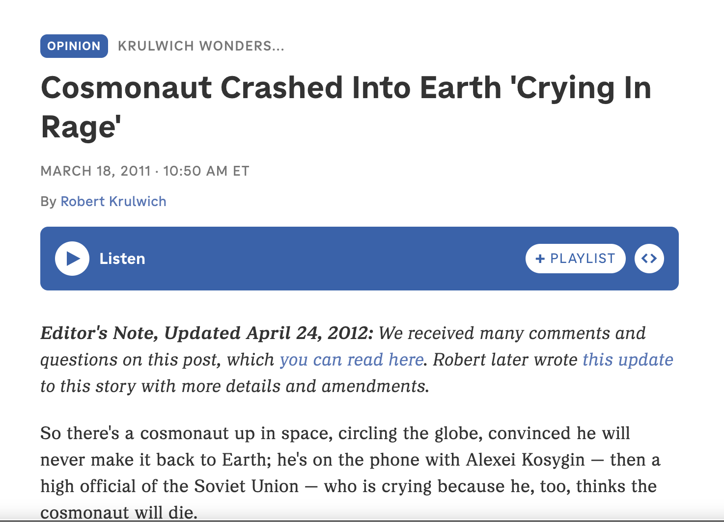
What makes NLP difficult - Word Sense
Polysemy - Same words can mean different things!
I have watered the plants
This course is watered down.
Synonyms - Find me all News on “astronauts”
Metonyms - figure of speech that replaces the
name of an object or concept with a closely related word
This dish tastes good
Hyponyms / Hypernyms - general / specific
I love Chinese food → I love Chow Mein
Is this relevant?

Slide 2
World knowledge is important to make Sense
Hyponyms / Hypernyms - general / specific
I love Chinese food → I love Chow Mein
Meronyms - Part - whole relationship
The car is blue → Its doors are blue
The wheels are not blue
Antonyms - Opposites
He said the movie is good while she said it’s bad → Opposite sentiments

Slide 3
Events - interpretation can be contextual
Citing high fuel prices, United Airlines said on Friday it has increased fares by $6 per round trip on flights to some cities also served by lower-cost carriers.
American Airlines, a unit of AMR Corp., immediately matched the move, spokesman Tim Wagner said.
United, a unit of UAL Corp., said the increase took effect Thursday and applies] to most routes where it competes against discount carriers, such as Chicago to Dallas and Denver to San Francisco.
India’s largest IT services company Tata Consultancy Services (TCS) on January 11 reported that its deal total contract value (TCV) for the third quarter ended December 31, came in at $8.1 billion, missing the company’s quarterly deal win guidance of $9-10 billion.
Infosys announced an agreement to acquire InSemi, a semiconductor design and embedded services provider.

Slide 4
Discourse Analysis
John took a train from Paris to Istanbul. He likes spinach.
Jane took a train from Paris to Istanbul. She had to attend a conference.
Are these two sentences equally coherent?
Reason?
How to measure coherence?

Slide 5
What can incoherence indicate
Mental Health Issues
Incoherent text messages used to identify stroke
I am very happy. She didn’t drink the milk today
Tjhe Doctor nddds a new bb

Slide 6
Similarity Measure

Slide 7
Information Retrieval - an example task that uses similarity of document to a query
Given a query - retrieve relevant Documents -
Query to document mapping
Establishing Similarity -
How to measure similarity between two text documents?
Handling Synonyms, Homonyms
nearest hospital?
There is a “Pain management clinic” 5 miles from here
cricket news

Slide 8
Vector Space Model
Term vector space is a n-dimensional space, where n is the number of different terms/tokens used to represent a set of documents
Vector for document I is d_{i} , represented by a vector w_{ij}
Binary vector
w_{ij} > 0 if term j occurs in document i
w_{ij} = 0 otherwise

Slide 9
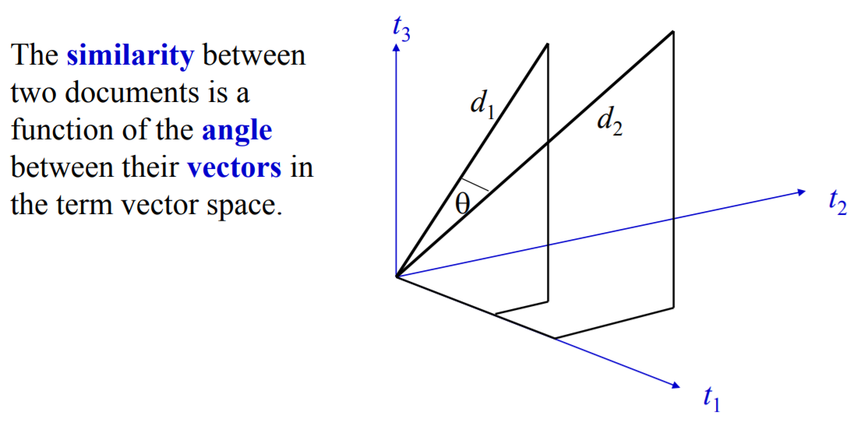
Similarity in Vector space
D1 – Ants eat sugar
D2 – Cows eat salt
D3 – Cows and ants are animals. They eat sugar
Ants | cows | animals | eat | salt | sugar | they
1 | 0 | 0 | 1 | 0 | 1 | 0
0 | 1 | 0 | 1 | 1 | 0 | 0
1 | 1 | 1 | 1 | 0 | 1 | 1

Slide 10
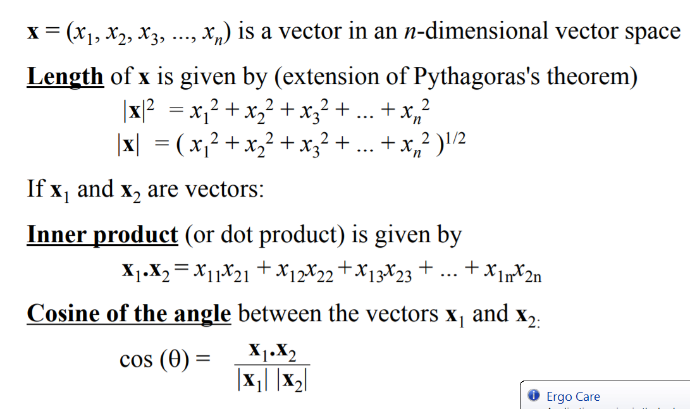
Computing Similarity

Slide 11
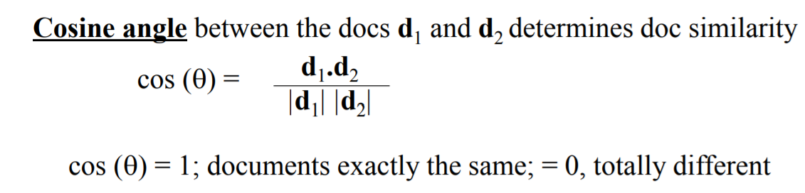
Cosine Similarity of Documents
Cosine Similarity = 1 implies one document is a complete subset of another
Implies angle between d1 and d2 = 0

Slide 12
Binary vector-based Similarity - example
Document | Ants | cows | animals | eat | salt | sugar | they | Length
D1 | 1 | 0 | 0 | 1 | 0 | 1 | 0 | 3
D2 | 0 | 1 | 0 | 1 | 1 | 0 | 0 | 3
D3 | 1 | 1 | 1 | 1 | 0 | 1 | 1 | 6
 | D1 | D2 | D3
D1 | 1 | 0.66
D2 | 0.66 | 1 | 0.47
D3 | 0.7 | 0.4 | 1

Slide 13
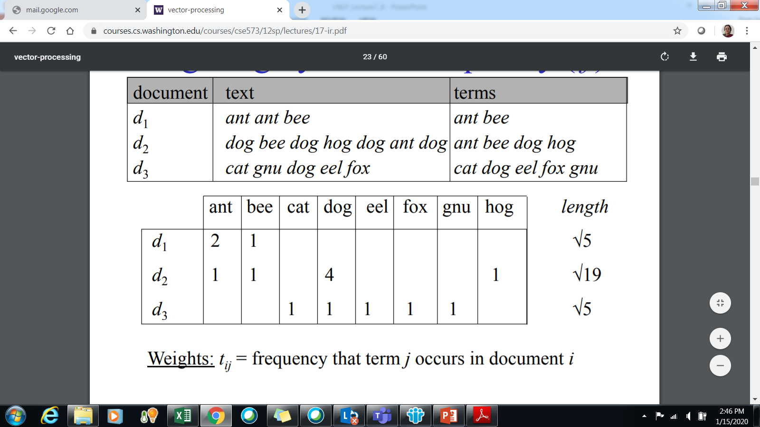
Term-frequency based approach
Words are repeated within a document – do they play a different role than the non-repeated ones?

Slide 14
Relatively important terms
Corpus – collection of documents
Frequent terms within a document are important indicators of their content
But most frequent terms are usually stop words
Their weightage needs to be reduced
Term Frequency
Weight of term within a document and corpus
Inverse Document Frequency
Can distinguish between frequent terms

Slide 15
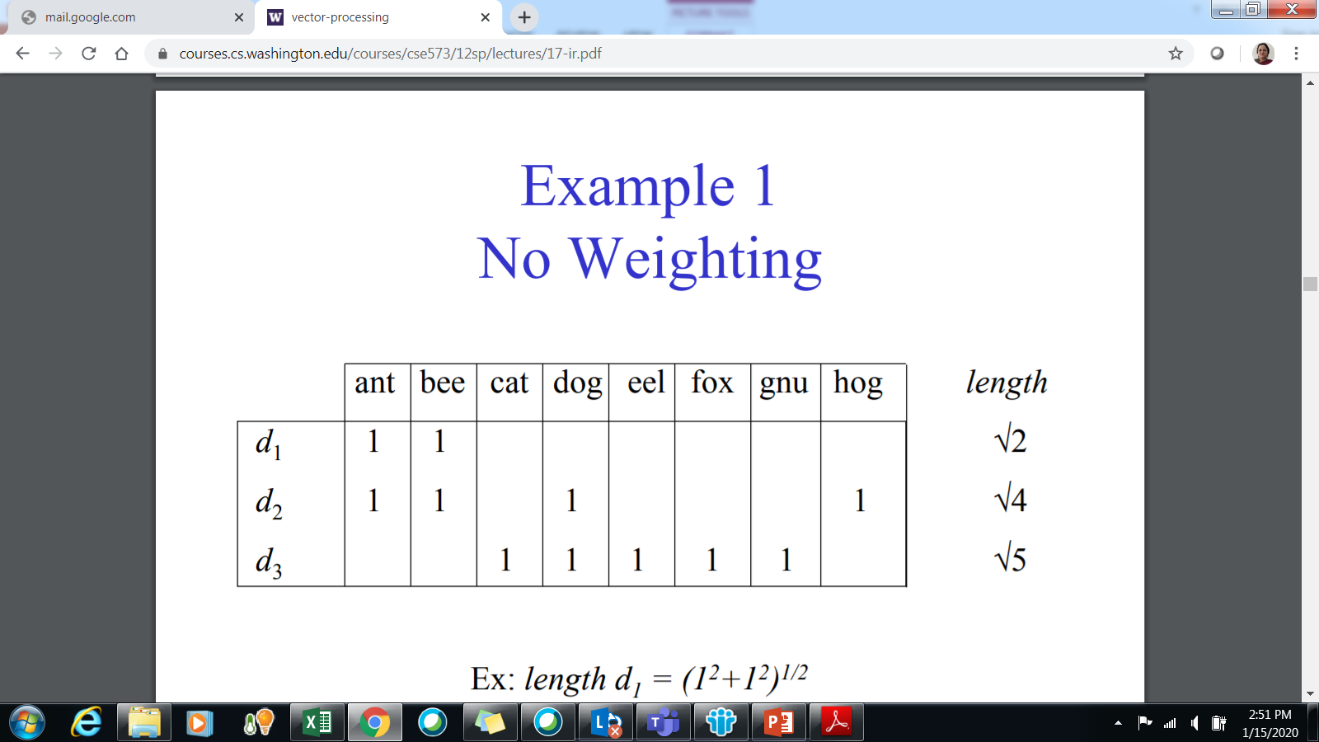
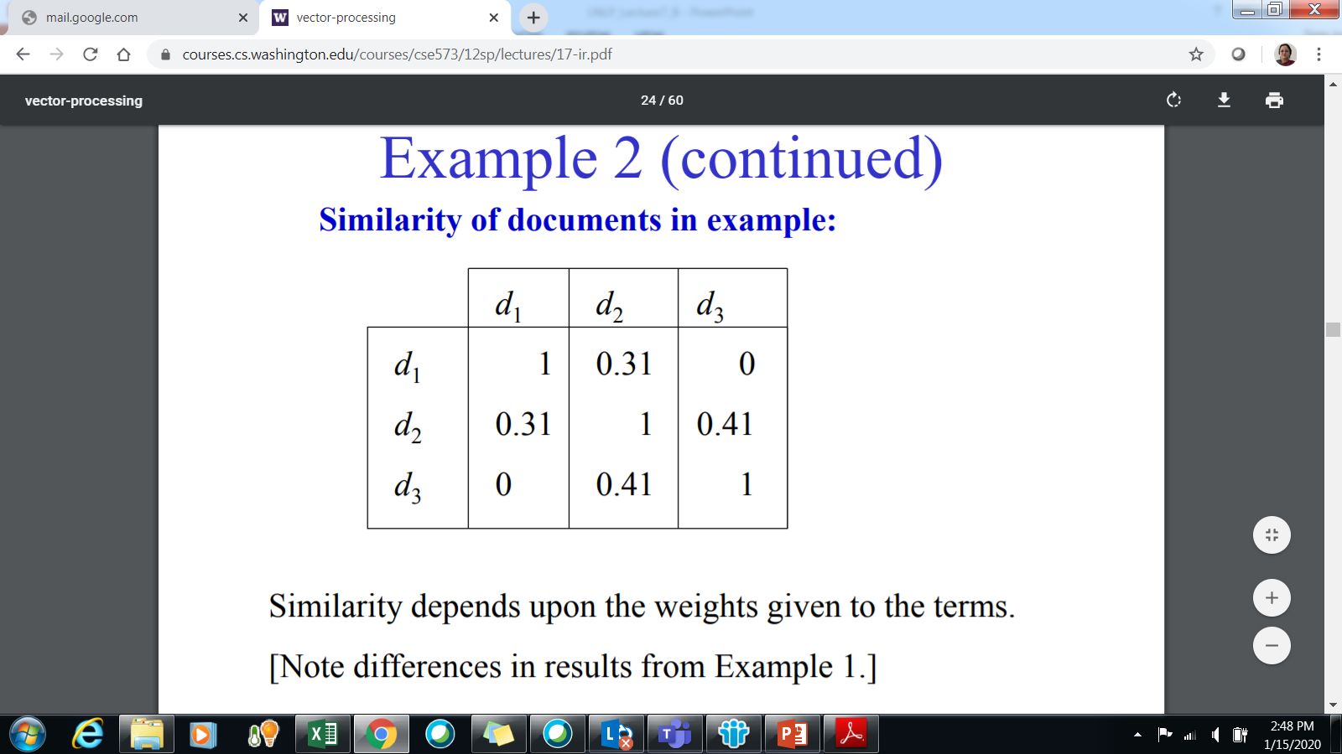
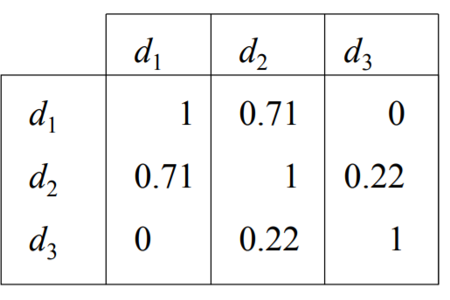
Binary Vector

Slide 16
Search and Cosine Similarity
Given a search query - from a large collection of documents those that contain most words from the query most often can be found
But is that enough?
How to differentiate which is “more relevant”?

Slide 17
Most frequent terms cannot always differentiate
Query - what do Data scientists do?
Data science and data analytics are closely related but there are key differences. While both fields involve working with data to gain insights, data science often involves using data to build models that can predict future outcomes, while data analytics tends to focus more on analyzing past data to inform decisions in the present.
The blessing and curse of this world is that we have tons of data, but not enough insight, and not enough people who care about extracting that insight. And that’s what data scientists do: they extract meaning from data. They help us understand the world and discover new things.

Slide 18
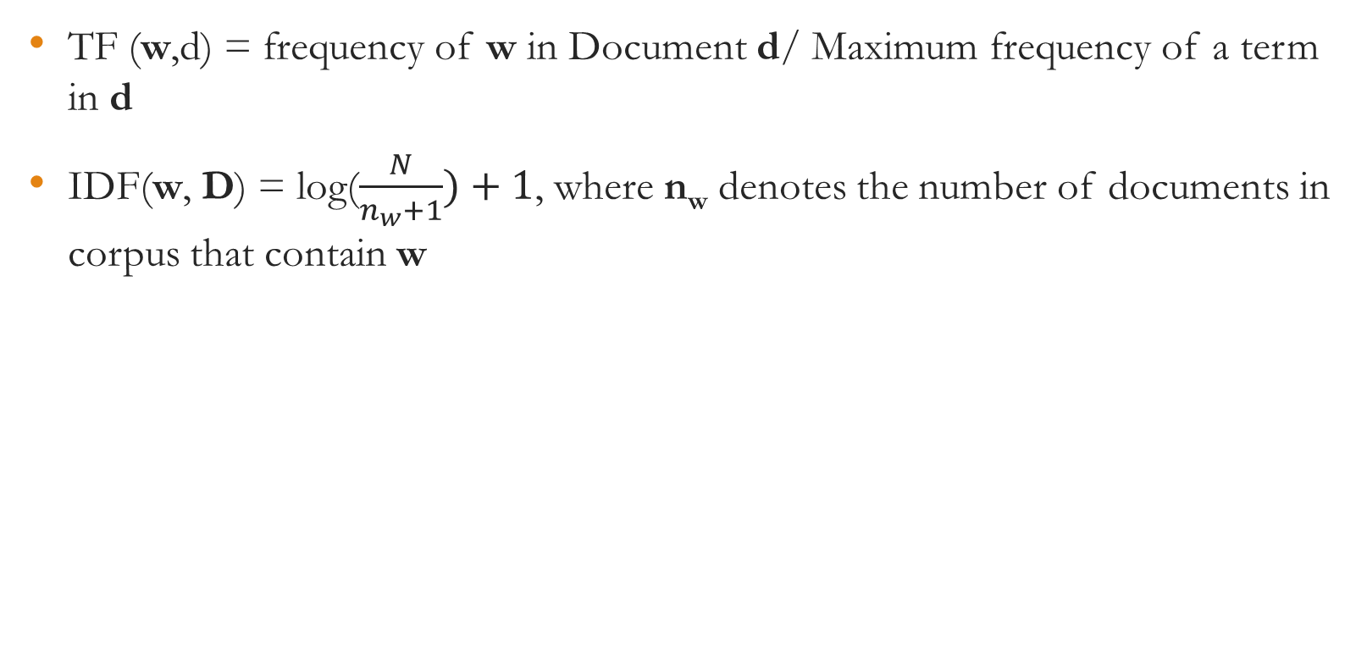
Computing TF-IDF
 | w1 | w2 | w3 |  |  | wn
d₁ | Tf(w₁,d₁) *IDF(w₁) |  |  |  |  | Tf(w_{n},d₁) *IDF(w_{n})
d₂ | TF(w₁,d₂)*IDF(w₁) |  |  |  |  | Tf(w_{n},d₂) *IDF(w_{n})
d_{N} | TF(w₁,d_{N})*IDF(w₁) |  |  |  |  | Tf(w_{n},d_{N}) *IDF(w_{n})

Slide 19
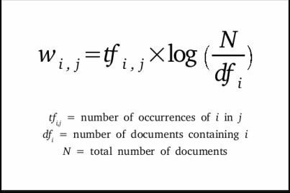
Massaging text inputs
Should we take all words?
Top words
TF – Idf
Fox – 1
As - 7
Fox – 0
As - 5
Fox – 2
As - 3
Dimensionality Reduction
As doesn’t make it to the list of top words
Doc | Fox | As
1 | 2 * log(3/2) | 3*log(3/3) = 0
2 | 0*log(3/2) | 5*log(3/3) = 0
3 | 1*log(3/2) | 7*log(3/3) = 0

Slide 20
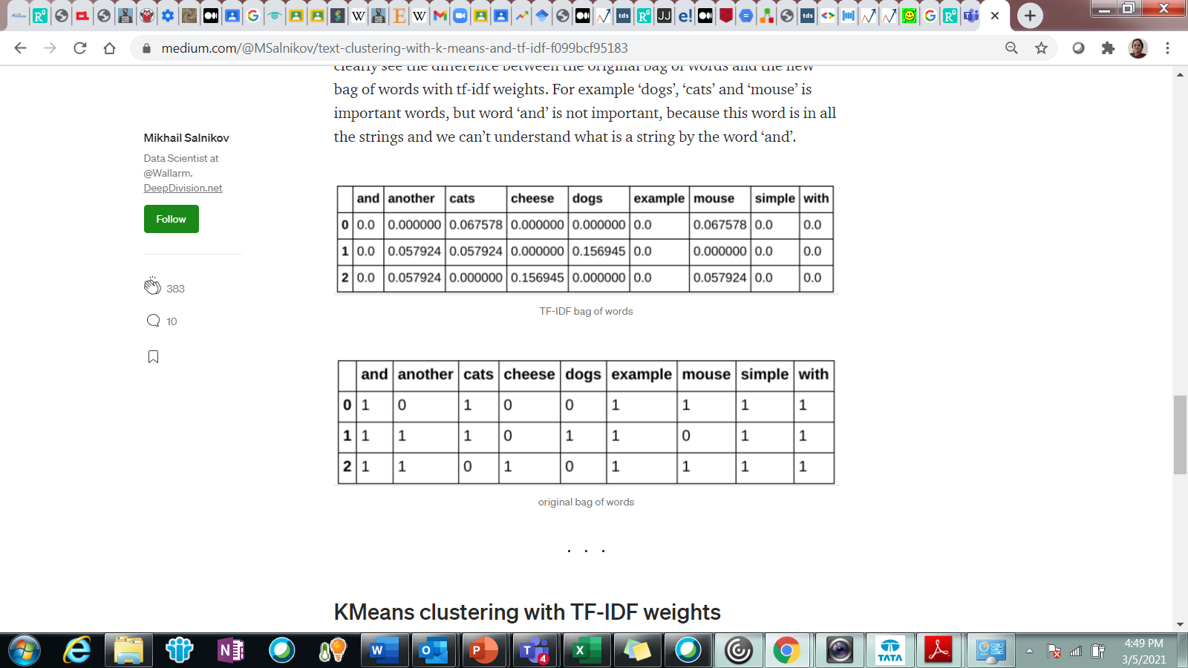
How it makes a difference

Slide 21
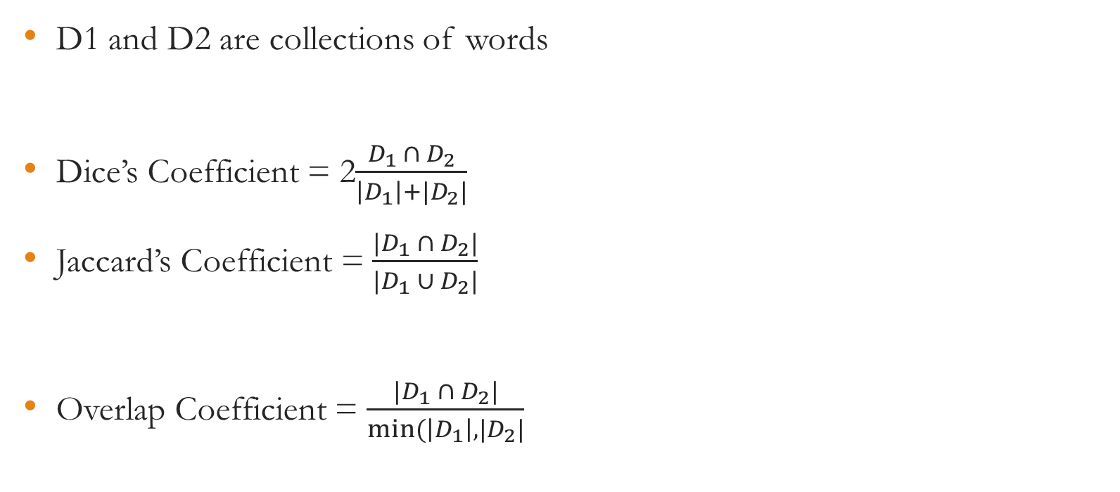
Other Similarity Measures

